Slide 1
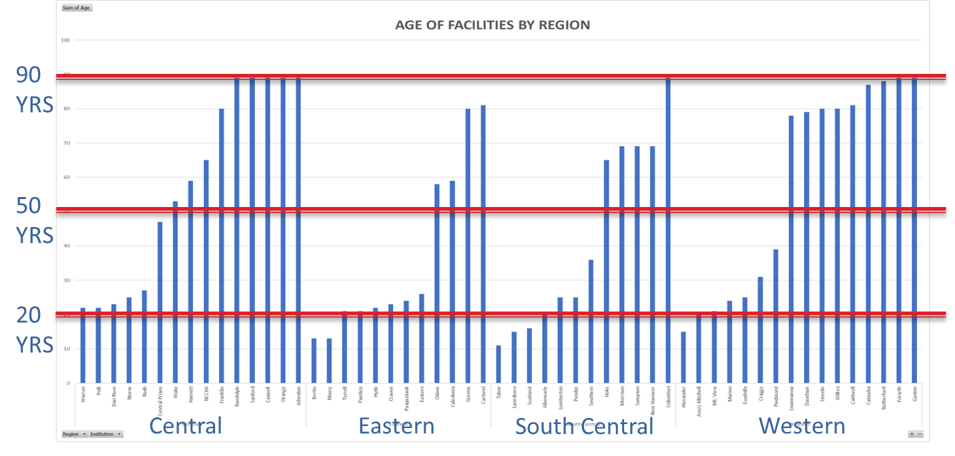
Aging Facilities Snap Shot

